Slide 1


Inflation and Rate Increase Effects on Home Sales
Group 4
Jeffrey Riebe, Meghan Kanegaye, Rudra Naik, Emma Perez

Slide 2
Questions:
How has the housing market changed in the last five years (2019-2024) given the effects of the COVID 19 pandemic?
Interest rates have fluctuated greatly - how has that affected purchasing (on an individual consumer level [i.e., consumables = CPI] and making larger purchases [homes]?
Who is buying houses?

Slide 3
Data sources:
U.S. Bureau of Labor and Statistics: https://www.bls.gov/data/
U.S Treasury: https://fiscaldata.treasury.gov/
Redfin Data Center: https://www.redfin.com/news/data-center/
Analysis based on areas from the top and bottom performing small and large cities of 2024 from The Milken Institute (https://milkeninstitute.org/sites/default/files/2024-02/BestPerformingCities2024.pdf):
Top Cities – Austin, TX (Large) and Idaho Falls, ID (Small)
Bottom Cities – Shreveport, LA (Large) and Pine Bluff, AR (Small)

Slide 4
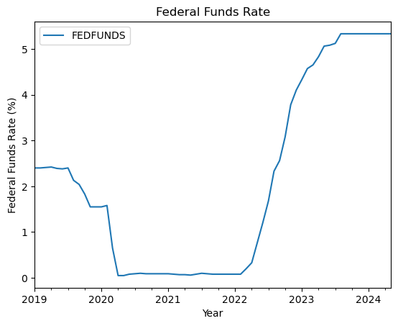
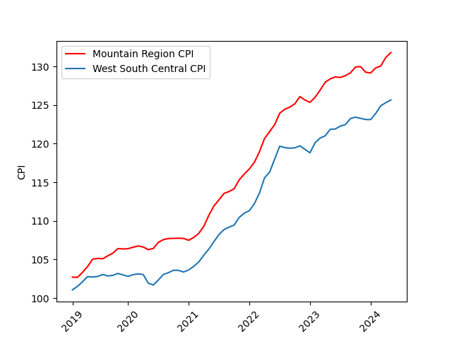
Interest Rates & Inflation
Prior to the onset of the pandemic, the federal funds rate was 2.16%, the highest that it had been in 10 years. In response to the pandemic, the US Federal Reserve drastically cut the fed funds rate to support the US economy, to its lowest point of 0.25%. As restrictions surrounding the pandemic loosened, the Federal Reserve was faced with the rising costs of consumer goods, or inflation.
To combat inflation, the Fed has aggressively raised the interest rate to the highest since before the 2008 Recession. The federal funds rate currently sits at its peak of 5.5% where it has been since July 2023.

Slide 5
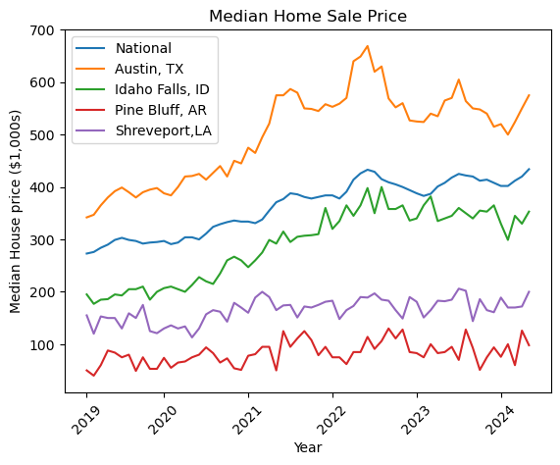
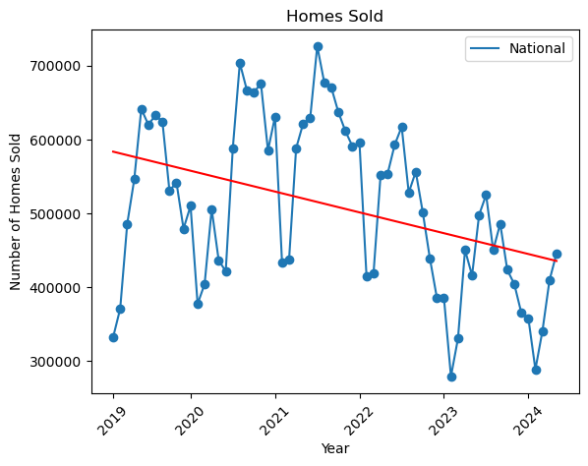
How has the market changed?
Steady increase in the median price of houses
Decrease in number of homes sold
Increases in home buying in 2020 and 2021 which correlates to the trough in interest rates.
Notes:
Since 2019, prices of houses have overall been increasing nationoally and in well-performing cities
prices have increased in a similar timeline as the increase in CPI (inflation)
however, have remained relatively stable in poorest-performing cities
As prices have increased, the quantity of homes sold has decreased

Slide 6
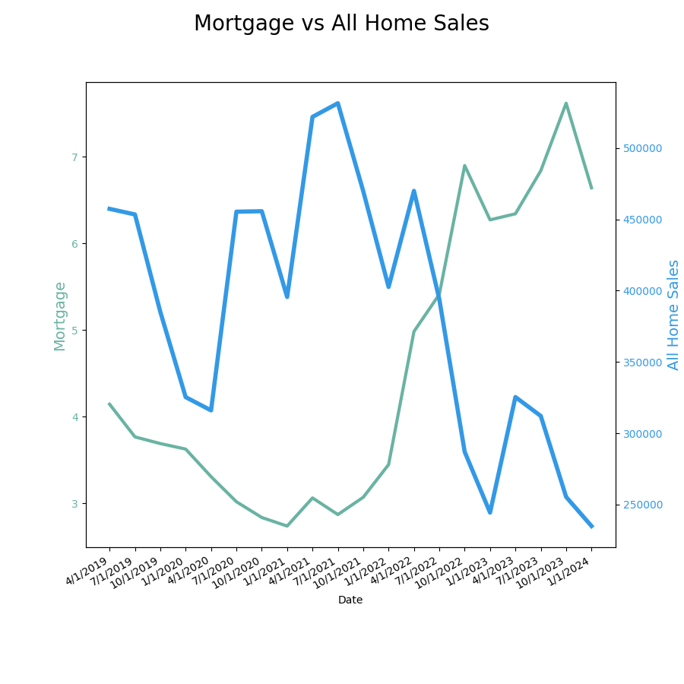
How has the market changed? (cont.)
Mortgage rates have followed the trend of the Fed Funds rate
Home sales climbed steadily during the pandemic as mortgage rates gradually dropped
As the Fed aggressively raised the borrowing rate and interest/mortgage rates rose, home sales declined drastically

Slide 7
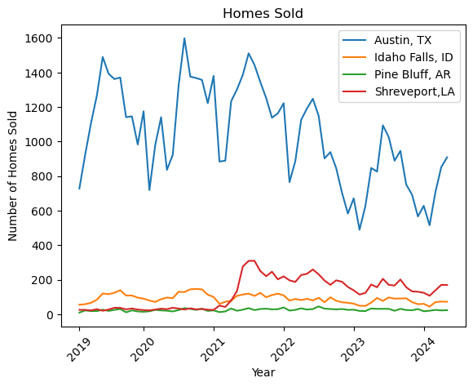
Who is buying/selling houses?
Most change in activity in large, well-performing cities
Relative stability in small, well-performing and large, low-performing
Jump in sales in small, low-performing city
Notes:
On an individual city level, Austin, TX sales activity very closely reflects the national sales,
whereas Idaho Falls, ID and Pine Bluff, AR activity remained relatively steady as well.
Shreveport, LA experienced an increase of purchasing activity in 2021, with a gradual taper off in the following years
hard to say why, but given the lack of economic opportunity, could be representative not of people buying houses and settling, but leaving these areas, and selling property

Slide 8
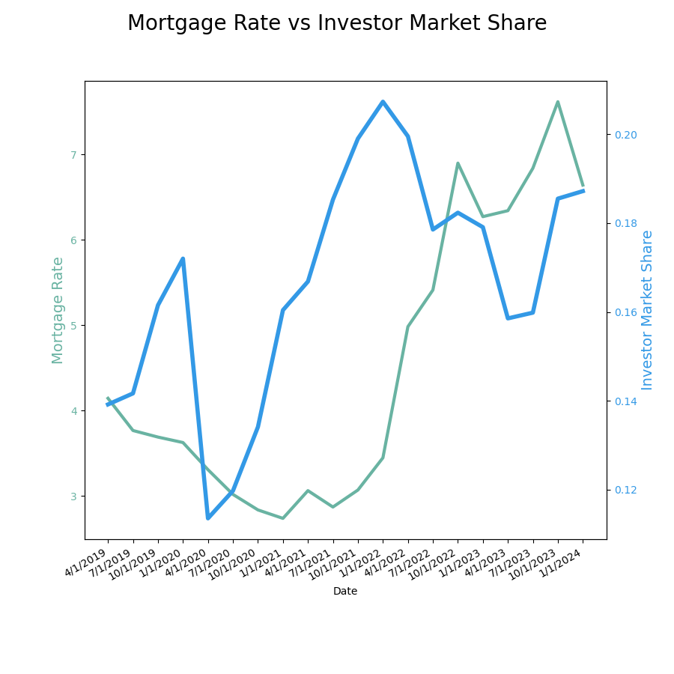
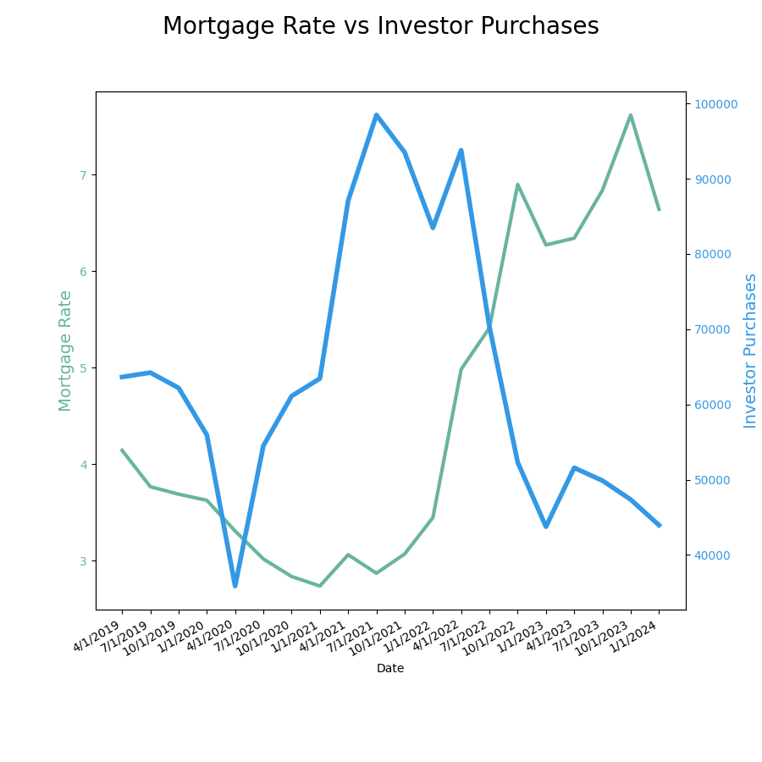
Who is buying?
As the cost of living for the average American household has increased, separate from housing costs, there has been a shift in who is purchasing homes.
Redfin defines investor as “We define an investor as any buyer whose name includes at least one of the following keywords: LLC, Inc, Trust, Corp, Homes.
Notes:
We also define an investor as any buyer whose ownership code on a purchasing deed includes at least one of the following keywords: association, corporate trustee, company, joint venture, corporate trust”
The number of houses purchased began to decrease in 2022 with the rise in inflation. However, around that same period, we see a sharp increase in the purchase of houses by investors

